Slide 1


Stuart Clayton
Dec 2, 2021

Slide 2

Outline
Executive Summary
Introduction
Methodology
Results
Conclusion
Appendix

Slide 3
Executive Summary
Summary of methodologies
Collection of data from unofficial SpaceX API
Collection of data from web scraping
Summary of all results
Launch site KSC LC-39A has the highest success rate
More launches occur from Florida launch sites than from California.
The success of launches increases continuously and considerably from 2013 up to 2020.
All launch sites are located on coasts.
The Decision Tree model was the best performing.

Slide 4
Introduction
Project background and context
SpaceX is arguably the most successful private rocket company today
They were the first to reuse a orbital booster
Reusable boosters is a key pillar of their business model and success
Problems you want to find answers
What makes their launches successful?
How many successful launches do they have?
How many successful landings do they have?
What is the true cost for launches?

Slide 5


Slide 6
Methodology
Executive Summary
Data collection methodology:
Data was collected via unofficial SpaceX API and web scraping
Perform data wrangling
Data was processed using Pandas and Numpy
Perform exploratory data analysis (EDA) using visualization and SQL
Perform interactive visual analytics using Folium and Plotly Dash
Perform predictive analysis using classification models
K-nearest Neighbors, Logistic Regression, Decision Tree, Support Vector Machine

Slide 7
Data Collection
Data was collected from https://api.spacexdata.com/v4/launches/past
Additional data was collected from web scraping Wiki pages
Data pulled from API using requests library.
Data frame created and columns of interest isolated.
Data cleaned using Pandas.
Data scraped from wiki pages using beautiful soup.
Data frame created from HTML.
Data frame cleaned by filtering through tables.

Slide 8
Data Collection – SpaceX API
SpaceX launch data extracted from API using helper functions.
Cleaning was done using Pandas.
Github link to SpaceX API call notebook.
request.get(spacex_url)
JSON data normalized using .json_normalize()
Helper fxns used to gather data for columns
Desired columns selected for dataframe
launch_dict created, turned into dataframe

Slide 9
Data Collection - Scraping
Additional data was gathered by web scraping Wikipedia.
BeautifulSoup was used to help process the raw HTML.
Github link to Web Scraping notebook.
request.get(wiki_url)
BeautifulSoup object created
Iterate through HTML and extract columns
find_all() used to find tables in HTML
Create dataframe by parsing launch HTML

Slide 10
Data Wrangling
Data analysis primarily acheived using Pandas
Identify missing values and data types for each column
Use .value_counts() to calculate number of launches from each site.
Use .value_counts() to explore the number of launches for different orbital targets.
Identify the different landing outcomes and the number of each.
Github link to Data Wrangling notebook.

Slide 11
EDA with Data Visualization
The primary charts used were scatter plot, bar and line.
Scatter plots were useful for:
Comparing Flight Number to Payload Mass
Comparing Flight Number to Launch Site
Comparing Payload Mass to Launch Site
Bar and line charts were used to compare Success Rate to Year
GitHub link to EDA with Visualization notebook.

Slide 12
EDA with SQL
Identify unique launch sites
Total payload mass launched by NASA
First successful landing outcome on ground pad
Total succesful and failed mission outcomes
Booster version which have carried maximum payload
Failed landing outcome on drone ship
Landing outcomes, between the date 2010-06-04 and 2017-03-20, in descending order
GitHub link to EDA with SQL notebook.

Slide 13
Build an Interactive Map with Folium
Add a Circle to better visualize on the map where the location is. Include popup with detailed description.
Add a Marker to better pinpoint the exact location.
Add MarkerCluster for areas with a lot of markers for better clarity.
Add MousePosition to extract latitude and longitude from map.
Add PolyLine to visualize distances between points.
GitHub link to Interactive Map with Folium notebook.

Slide 14
Build a Dashboard with Plotly Dash
The dashboard provides two main graphical views.
The pie chart displays the percentage of succssful or failed launches at each site.
The scatter plot displays the Payload Mass and Class for each booster.
GitHub link to Dashboard with Plotly Dash python file.

Slide 15
Predictive Analysis (Classification)
Data standardized, train/test split created.
Identify parameters to test for each model.
Fit model using X_train, Y_train
Create model object and GridSearchCV object
Determine accuracy score and confusion matrix
Models were all created and developed using sklearn.
Data standardized using StandardScaler()
Train/test splits created from dataset
Different models tests (KNN, decision tree, logistic regression, SVM)
GitHub link to Predictive Analysis notebook.

Slide 16
Results
Exploratory data analysis results
Launch sites: CCAFS LC-40, CCAFS SLC-40, KSC LC-39A, VAFB SLC-4E
Payload mass launched at each site varies
ES-L1, GEO, SSO, and HEO orbits have 100% success rate
Launch success trend increases from 2013 until 2020 (end of data)
Predictive analysis results
The best performing algorithm was Decision Tree.

Slide 17
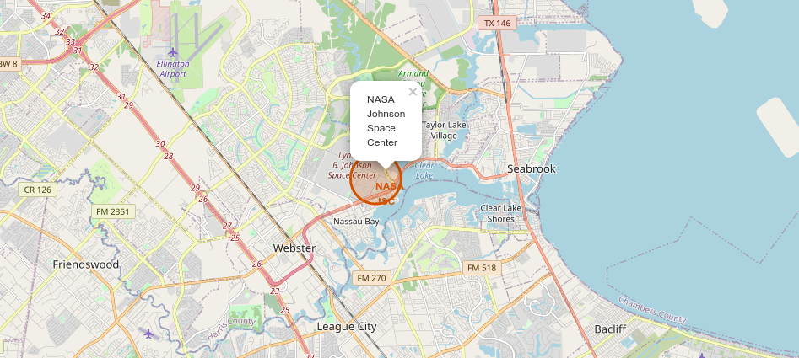
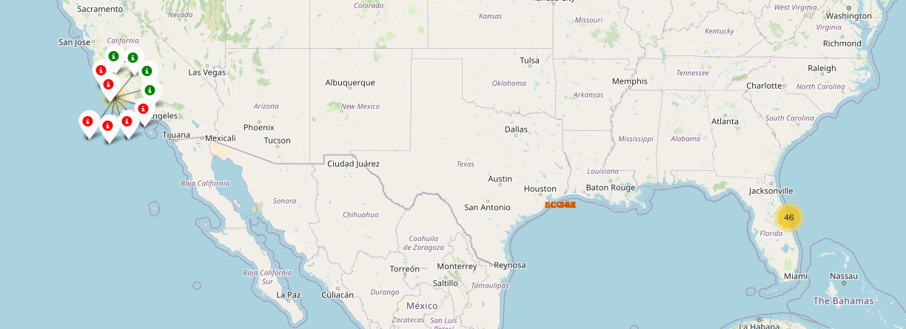
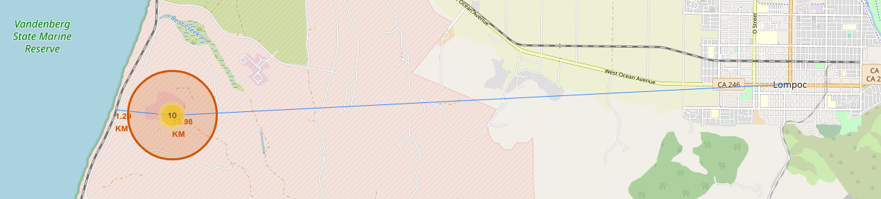
Results
Interactive analytics

Slide 18


Slide 19
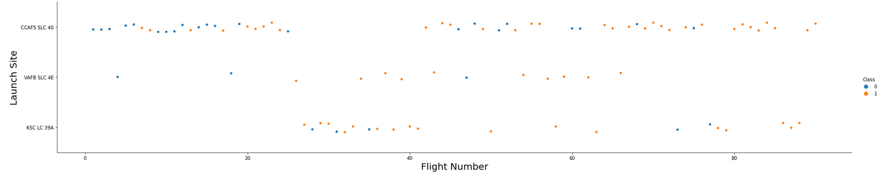
Flight Number vs. Launch Site
Launch site VAFB SLC-4E appears to have the least launches. Launches from KSC LC-39A began occuring later into the companies history.

Slide 20
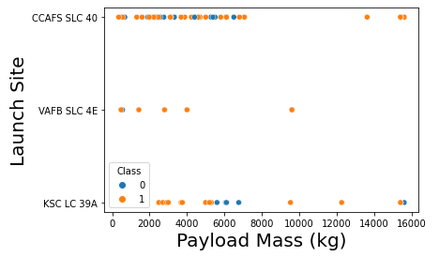
Payload vs. Launch Site
VAFB SLC-4E has no launches with a payload mass over 10000 kg.
Both CCAFS SLC-40 and KSC LC-39A support heavy launches up to around 16000 kg.

Slide 21
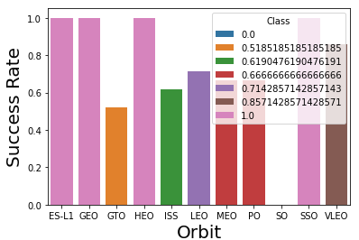
Success Rate vs. Orbit Type
Orbits ES-L1, GEO, HEO, SSO have a 100% success rate.
GTO and ISS have a lower success rate at around 50% to 60%.

Slide 22
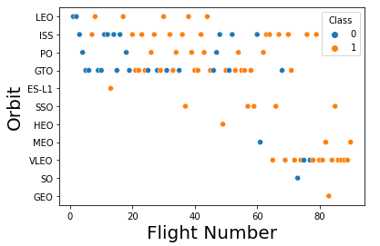
Flight Number vs. Orbit Type
For LTO, the success appears to be related to the flight number.
GTO appears to have no correlation, as do most other orbit types.

Slide 23
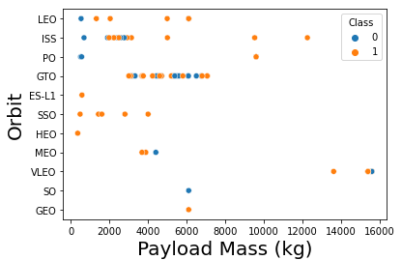
Payload vs. Orbit Type
PO, LEO, and ISS have higher success rates with a heavier payload.
GTO, GEO, SO and others have no apparent correlation.

Slide 24
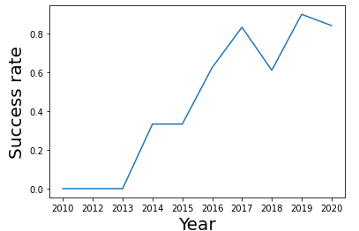
Launch Success Yearly Trend
Success rate increases starting in 2013 up untill 2020, when the data collected ends.

Slide 25
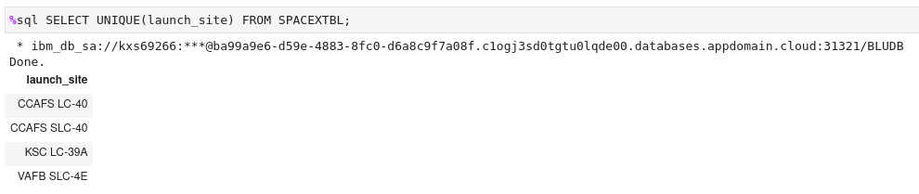
All Launch Site Names
There are 4 unique launch sites.

Slide 26
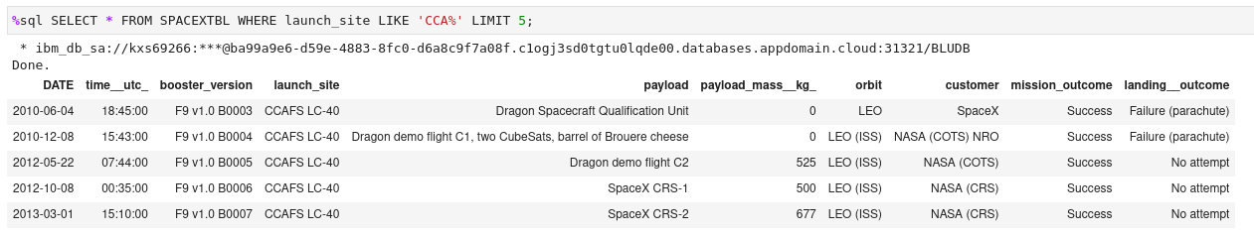
Launch Site Names Begin with 'CCA'
Find 5 records where launch sites begin with `CCA`

Slide 27
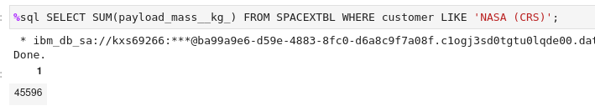
Total Payload Mass
Calculate the total payload carried by boosters from NASA. Number given is in kg.

Slide 28
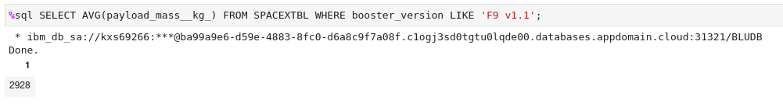
Average Payload Mass by F9 v1.1
Calculate the average payload mass carried by booster version F9 v1.1

Slide 29
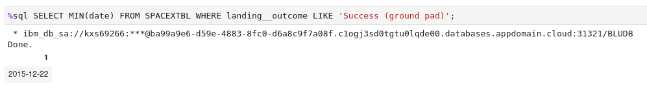
First Successful Ground Landing Date
Find the dates of the first successful landing outcome on ground pad

Slide 30
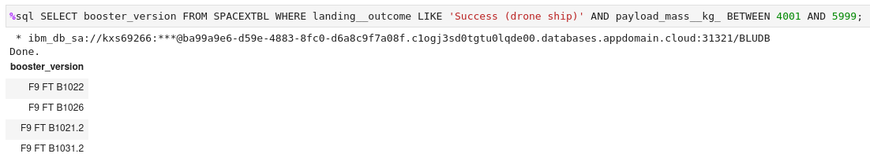
Successful Drone Ship Landing with Payload between 4000 and 6000
List the names of boosters which have successfully landed on drone ship and had payload mass greater than 4000 but less than 6000

Slide 31
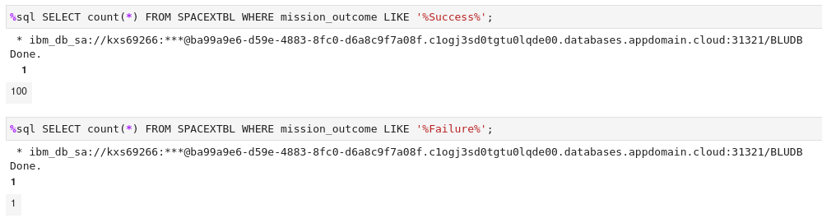
Total Number of Successful and Failure Mission Outcomes
Calculate the total number of successful and failure mission outcomes

Slide 32
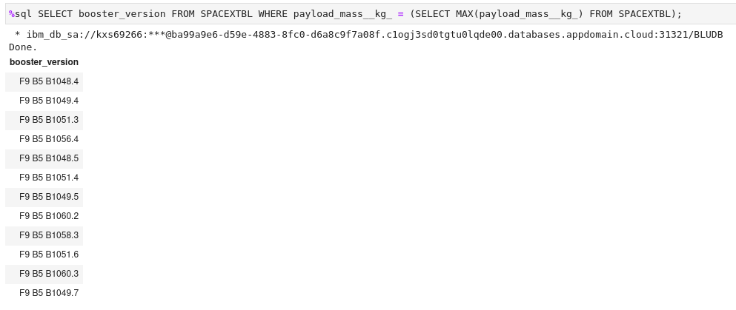
Boosters Carried Maximum Payload
List the names of the booster which have carried the maximum payload mass

Slide 33
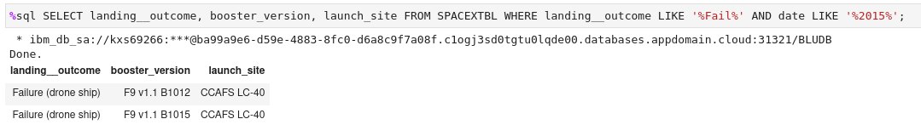
2015 Launch Records
List the failed landing_outcomes in drone ship, their booster versions, and launch site names for in year 2015

Slide 34
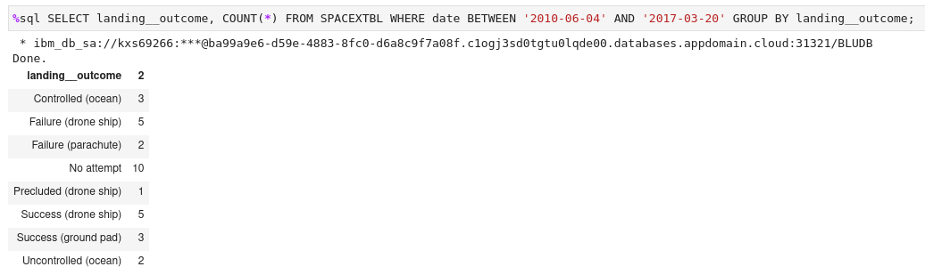
Rank Landing Outcomes Between 2010-06-04 and 2017-03-20
No attempt had the most landings outcomes, Success and failure drone ship both had 5. All others had 3 or fewer attempts.

Slide 35


Slide 36
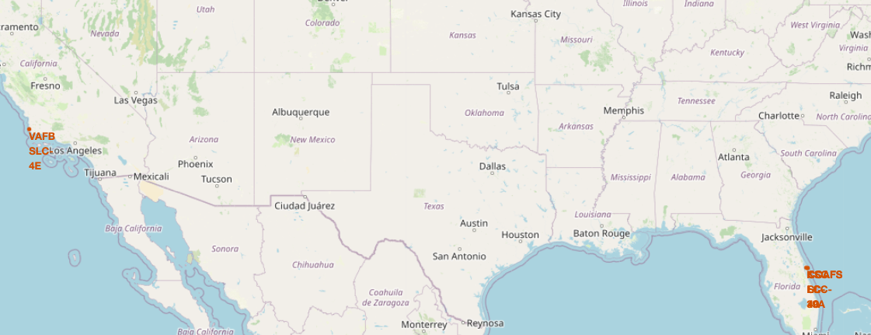
Launch sites US map
Displays the different launch sites in the US

Slide 37
Success Vs Failed launches
The markers indicate if the launch was successful (green) or failed (red)

Slide 38
Launch site proximity map
Shows the proximity of VAFB to the nearest road and to the nearest city

Slide 39


Slide 40
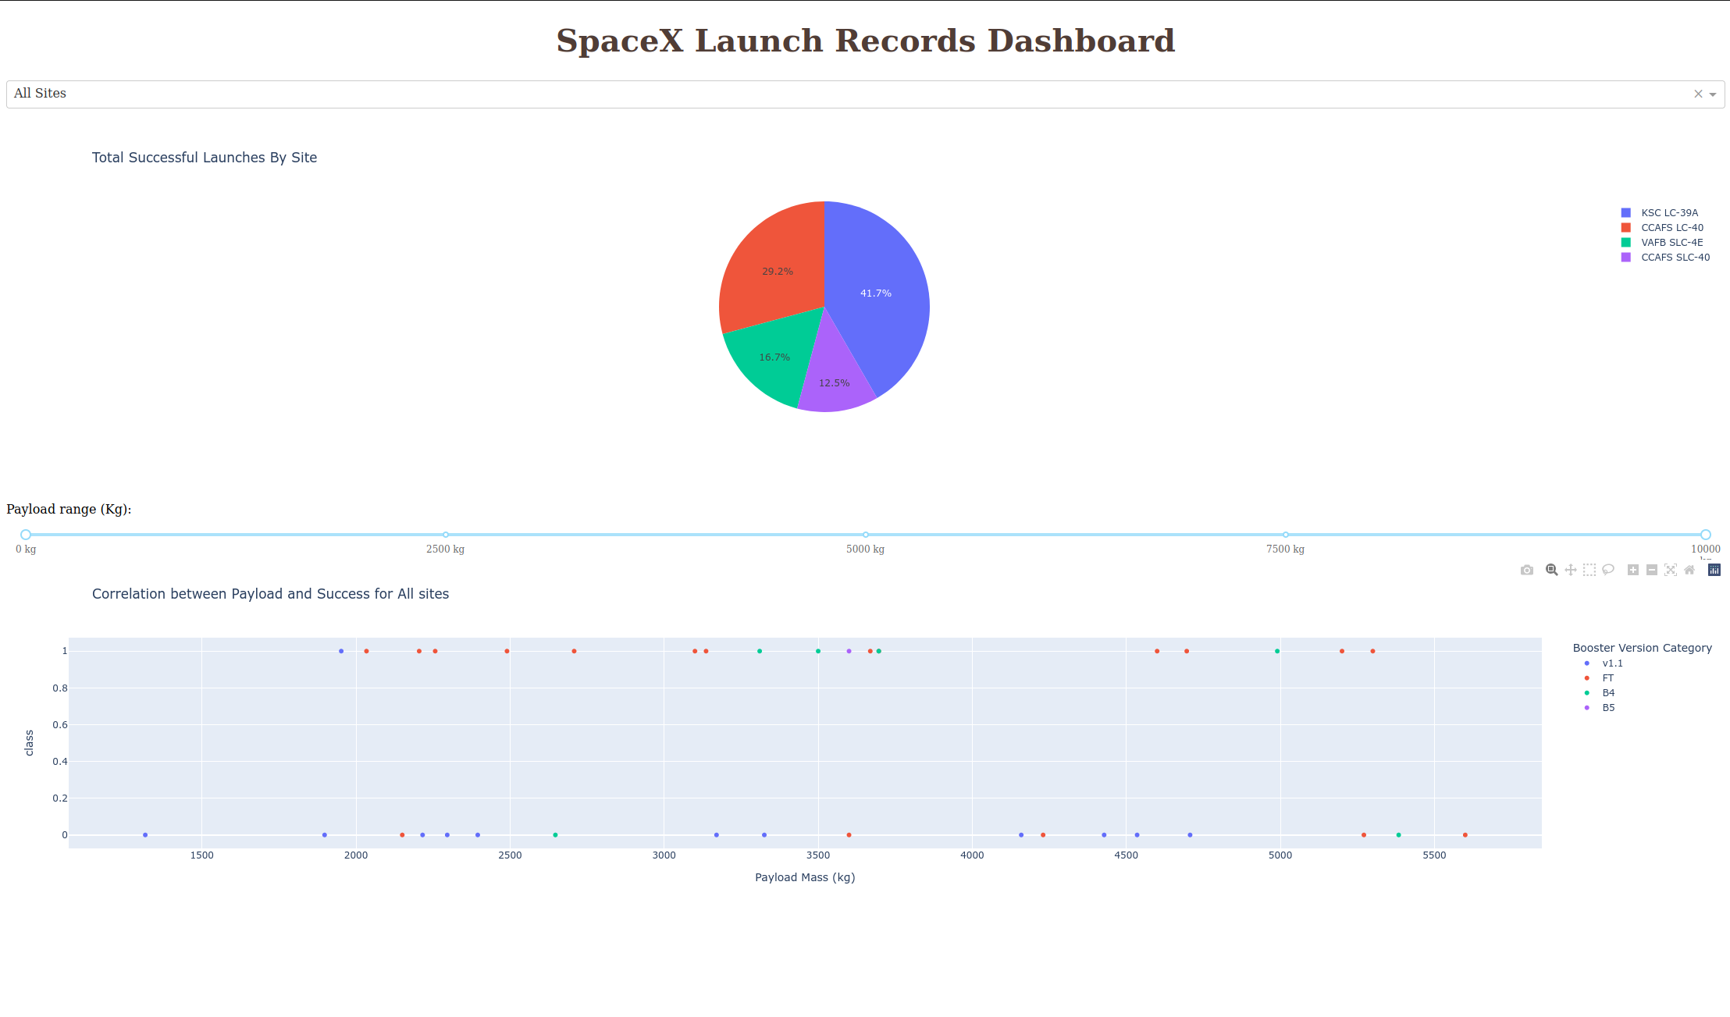
Dashboard Overview
Over 40% of successful launches are from KSC LC-39A.

Slide 41
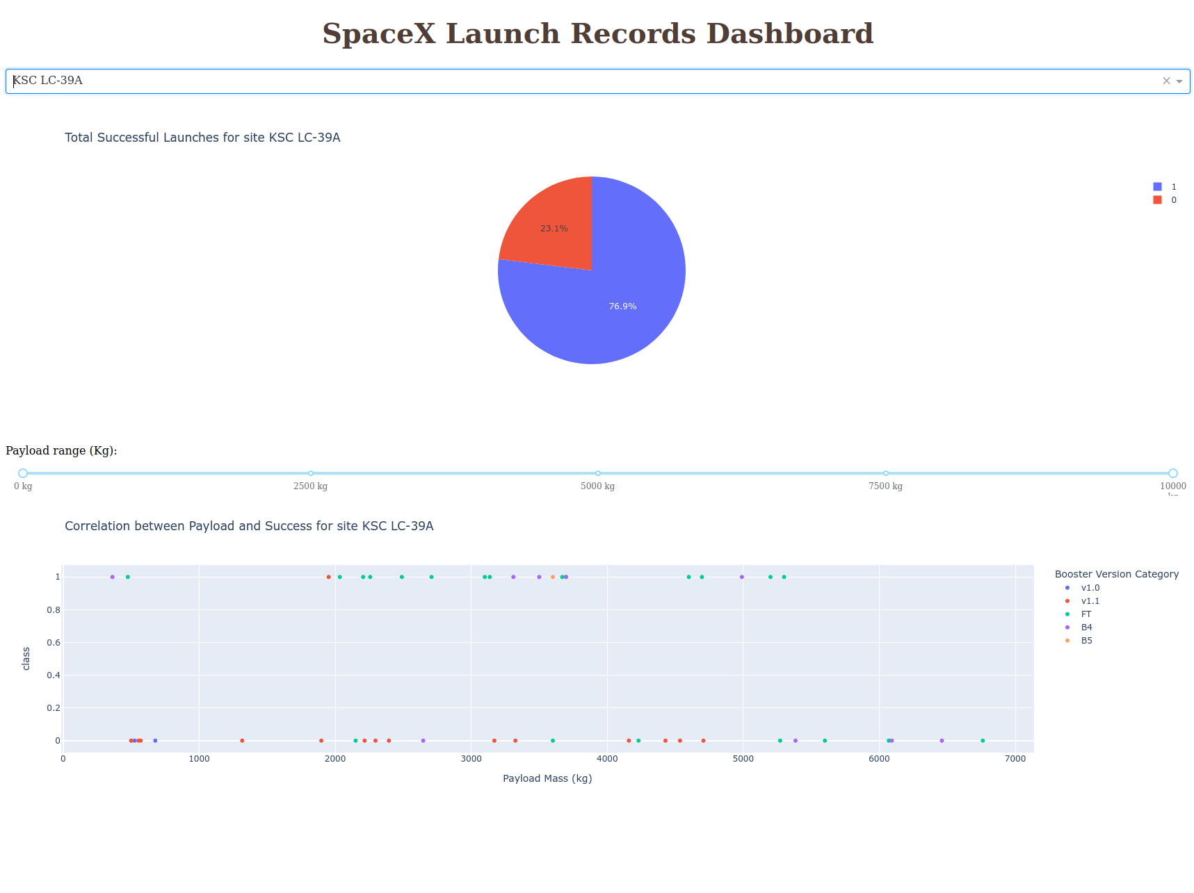
Launch site with highest success rate
Launch site KSC LC-39A has the highest success rate.

Slide 42
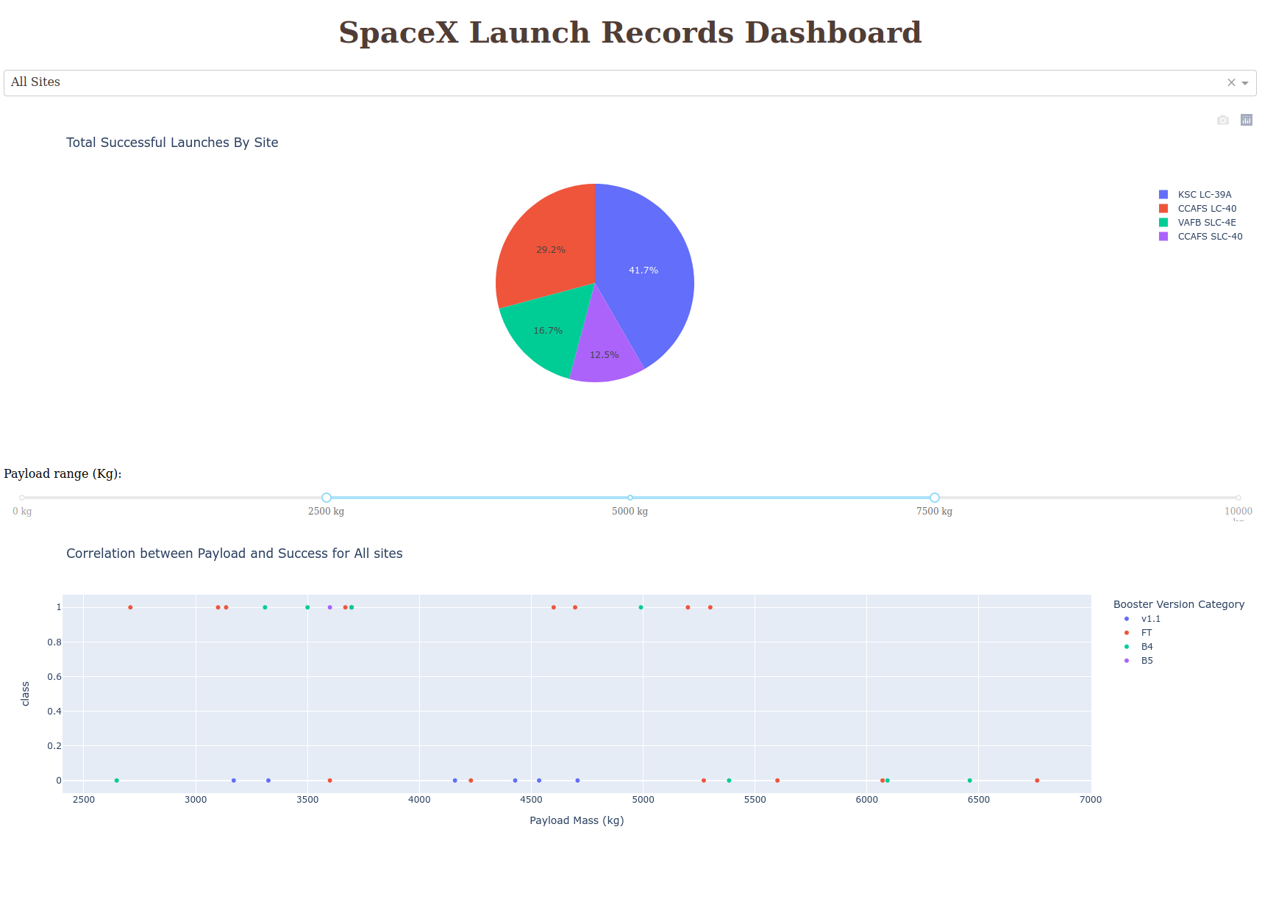
Payload vs. Launch Outcome
Payload range between 2000 and 6000 have the highest success rate. Booster version FT has highest success rate.

Slide 43


Slide 44
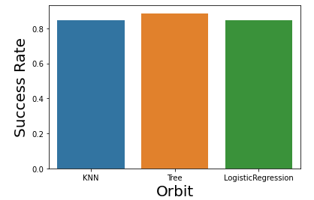
Classification Accuracy
Decision Tree has the highest accuracy

Slide 45
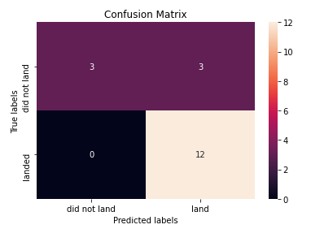
Confusion Matrix
The Decision Tree model was the best performing. It has the highest accuracy.

Slide 46
Conclusions
Launch site KSC LC-39A has the highest success rate
More launches occur from Florida launch sites than from California.
The success of launches increases continuously and considerably from 2013 up to 2020.
All launch sites are located on coasts.
The Decision Tree model was the best performing.

Slide 47
Appendix
Include any relevant assets like Python code snippets, SQL queries, charts, Notebook outputs, or data sets that you may have created during this project.
Link to screenshots used in this report.

Slide 48


